Slide 1


Real-Time Big Data Ingestion Pipeline from Distributed Sources
CSA1522-CLOUD COMPUTING & BIG DATA ANALYTICS
Guided by :
Dr. Rajaram P
Name of the student :
Gali Venkata Niranjan Reddy (192525199)
Mamidi Jaya Krishna (192524500)
Manukondu Sandeep (192525095)

Slide 2
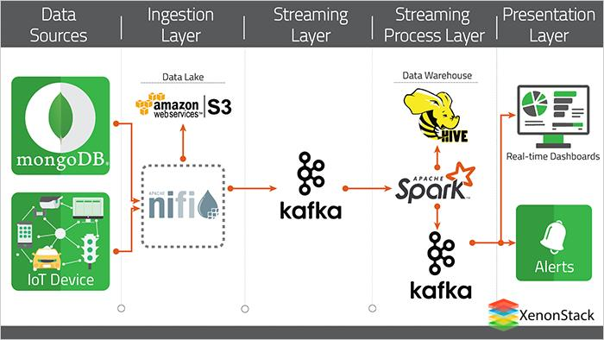
Introduction
Big Data applications generate massive volumes of data from multiple distributed sources in real time.
Data may come from IoT devices, sensors, web applications, social media, servers, and enterprise systems.
Traditional data processing methods may not handle high-velocity and continuously generated data efficiently.
A real-time big data ingestion pipeline collects, processes, stores, and visualizes data with minimum delay.
Notes:
Image source: https://pub.mdpi-res.com

Slide 3
Abstract
Ingests high-velocity data from multiple sources.
Uses Apache Kafka for real-time data ingestion.
Uses Apache Spark Streaming for data processing.
Uses HDFS/S3 for large-scale data storage.
Uses Grafana/Kibana for real-time visualization.
Provides reliable and scalable data processing.
Notes:
Image source: https://www.mdpi.com

Slide 4
Literature Review
Author(s) & year | Study focus | Methodology | Key findings | Gaps identified
Springer KAIS study (2022) | Distributed real-time ETL for unstructured data | Novel architecture with stream-disk join | Proposes a partition-based, best-effort in-memory join technique that ingests unstructured multi-source streams without prior schema knowledge, cutting disk access. | Governance and schema-drift handling left for future work
Yaghi (2025) | Big data ingestion and preparation tools | Comparative review of tools | Analyzes Kafka, NiFi, Flume, Sqoop, and Spark across batch and stream ingestion, recommending separation of storage and processing layers. | Real-time governance and integration complexity remain unresolved
Beevi (2025) | Scalable data pipelines for real-time analytics | Comparative survey of streaming frameworks | Compares state-of-the-art frameworks on performance, fault tolerance, and cost-effectiveness for scalable ingestion pipelines. | Cost-effectiveness metrics not validated against production deployments
MDPI review (2025) | Evolution and challenges of real-time big data | Systematic review (2020–2025 literature) | Finds Kafka Streams, Flink, and Spark Streaming have cut latency and raised throughput; notes growing use of explainable AI and incremental learning atop ingestion pipelines. | Interoperability between edge computing and centralized streaming layers underexplored
Notes:
Image source: https://www.mdpi.com

Slide 5
Problem statements
Modern applications generate huge volumes of data continuously from distributed sources such as IoT devices, applications, APIs, databases, and system logs.
Traditional batch-processing systems cannot process this continuously generated data with low latency.
Data arrives at different speeds and in different formats, making integration and processing difficult.
Delayed data processing can affect real-time monitoring and decision-making.
Notes:
Image source: https://www.mdpi.com

Slide 6
Objectives
To design a real-time pipeline for ingesting high-velocity data from multiple distributed sources.
To use Apache Kafka for reliable distributed messaging and real-time data ingestion.
To process and transform streaming data using Apache Spark Streaming.
To store large-scale processed data using HDFS or cloud storage such as Amazon S3.
To visualize real-time analytics and pipeline performance using Grafana/Kibana.
Notes:
Image source: https://pub.mdpi-res.com

Slide 7
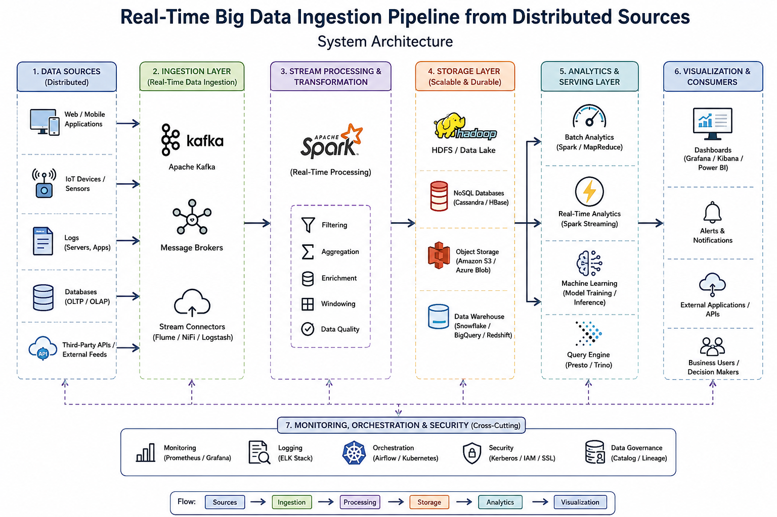
Notes:
Image source: https://pub.mdpi-res.com

Slide 8
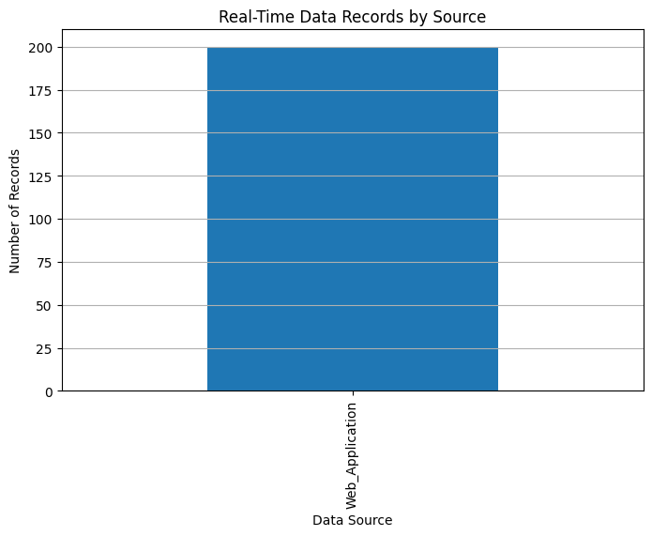
Module 1 – Multi-Source Data Ingestion Module
Collects real-time data from multiple distributed sources such as IoT devices, sensors, applications, and server logs.
Apache Kafka acts as the distributed messaging and data ingestion platform.
Kafka topics organize incoming data streams and allow multiple consumers to process data independently.
Features
Multi-Source Data Collection
Apache Kafka Producers
Kafka Topics and Partitions
Notes:
Image source: https://pub.mdpi-res.com

Slide 9
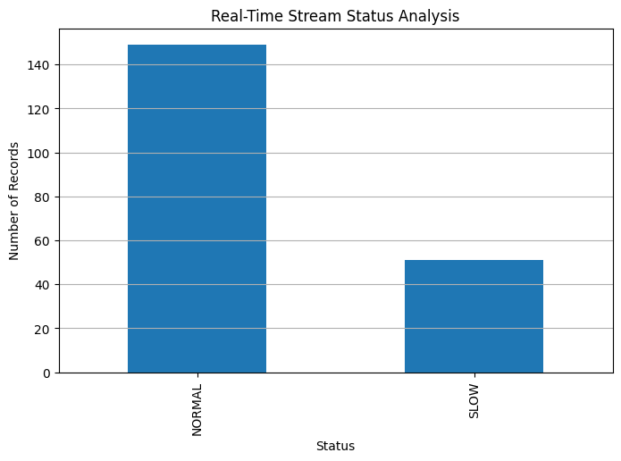
Module 2 – Stream Processing & Transformation Engine
Receives continuous data streams from Apache Kafka.
Apache Spark Streaming processes incoming data in real time or near real time.
Performs data cleaning, filtering,transformation, aggregation, and feature extraction.
Features
Real-Time Stream Processing
Data Cleaning
Data Filtering
Data Transformation
Notes:
Image source: https://pub.mdpi-res.com

Slide 10
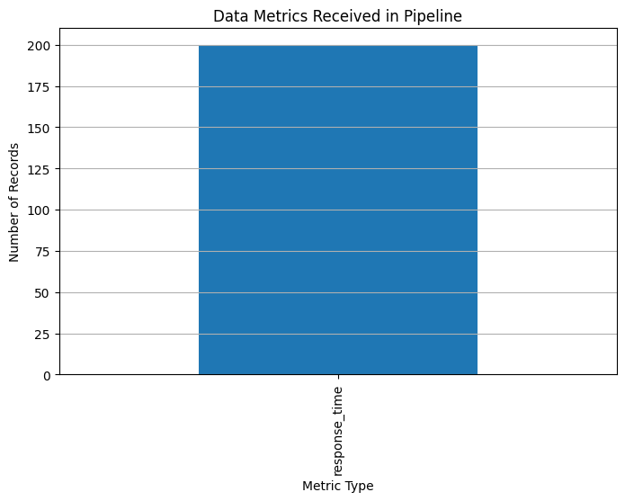
Module 3 – Cloud Storage & Visualization Dashboard
Stores raw and processed big data in distributed storage systems.
HDFS can be used for distributed on-premise storage, while Amazon S3 provides scalable cloud-based object storage.
Processed data is made available for analytics and long-term
storage.
Features
HDFS/S3 Data Storage
Scalable Cloud Storage
Historical Data Management
Real-Time Data Visualization
Notes:
Image source: https://pub.mdpi-res.com

Slide 11
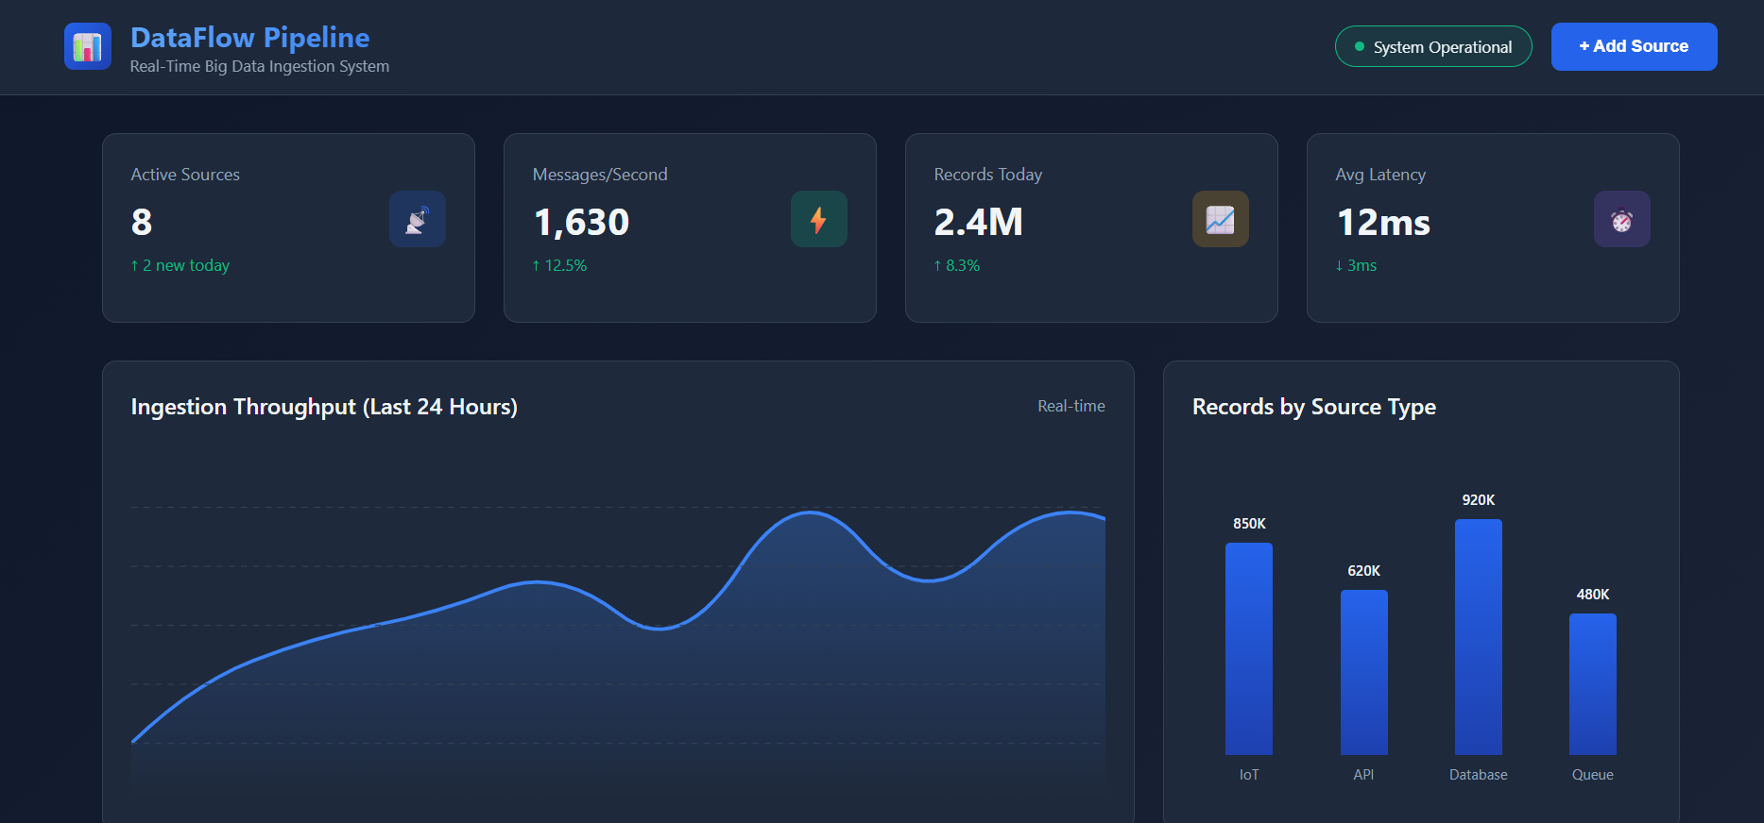
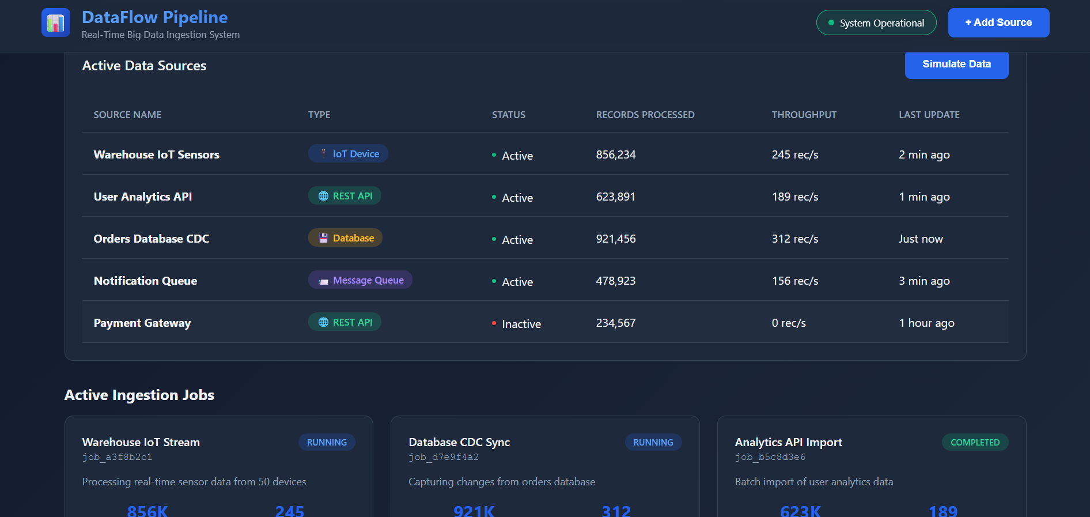
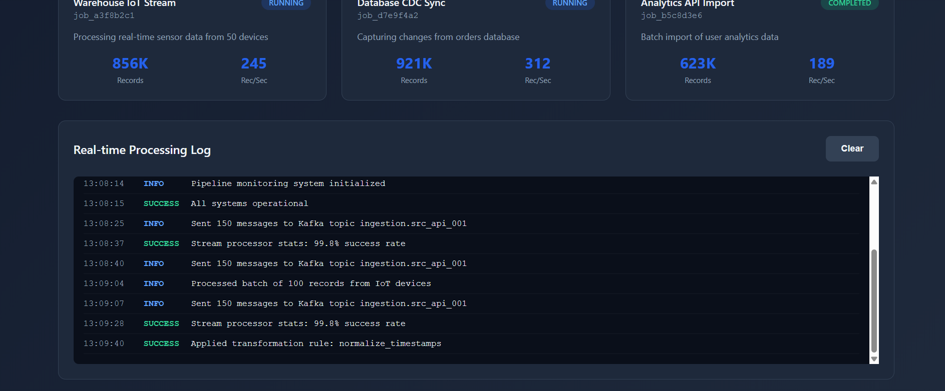
Implementation

Slide 12
Techniques Used
Stream Processing
Distributed Messaging using Apache Kafka
Big Data Pipeline Design
Data Serialization
Apache Spark Streaming
Distributed Storage using HDFS/S3
Real-Time Data Visualization
5Vs of Big Data: Volume, Velocity, Variety, Veracity, and Value
Notes:
Image source: https://pub.mdpi-res.com

Slide 13
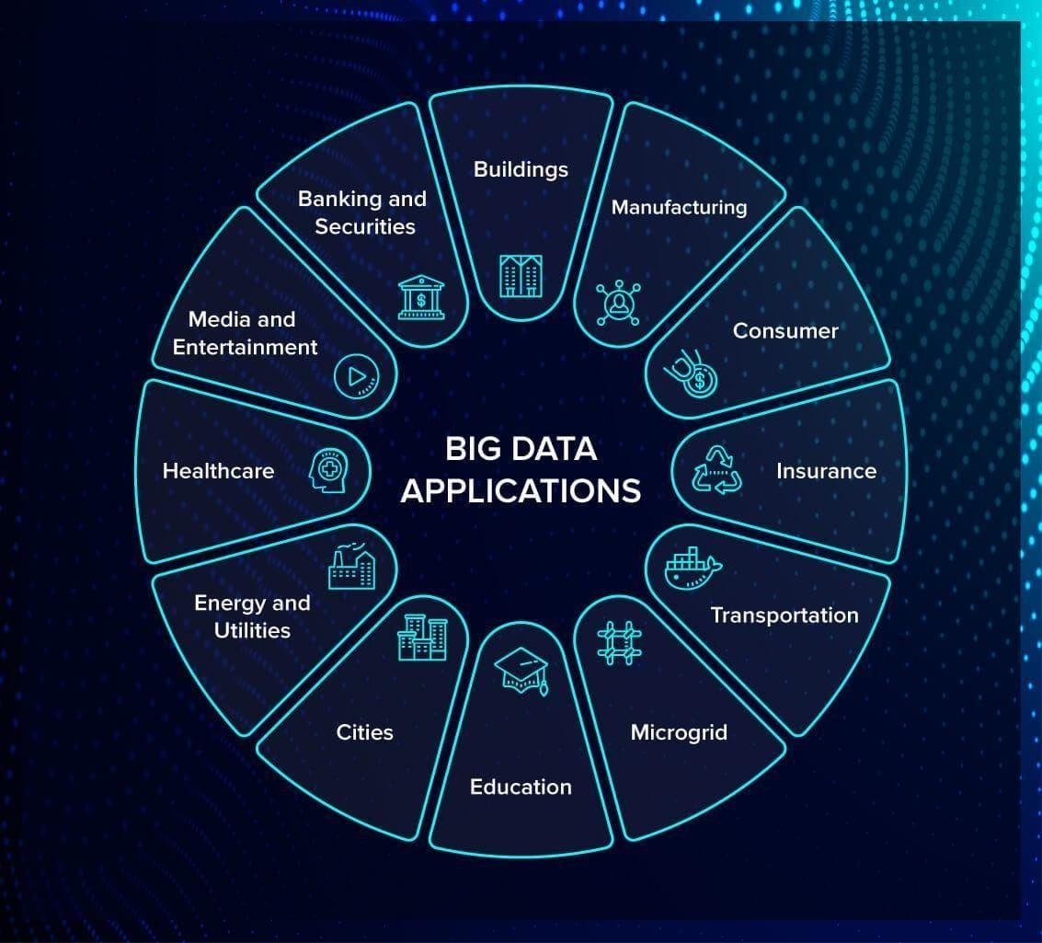
Applications
IoT and Smart City Data Processing
Real-Time Financial Transaction Monitoring
Fraud Detection Systems
Social Media Analytics
Healthcare Monitoring Systems
Industrial and Manufacturing Monitoring
E-Commerce Recommendation Systems
Notes:
Image source: https://www.mdpi.com

Slide 14
Future Scope
Integrate more IoT and enterprise data sources.
Implement advanced anomaly detection.
Add machine-learning-based real-time prediction.
Use containerization with Docker and Kubernetes.
Implement automatic scaling.

Slide 15
Conclusion
Provides real-time ingestion of distributed data.
Kafka enables reliable data streaming.
Spark Streaming enables fast data processing.
HDFS/S3 provides scalable data storage.
Grafana/Kibana provides real-time visualization.
The pipeline supports reliable and low-latency analytics.
Notes:
Image source: https://pub.mdpi-res.com

Slide 16
References
Pacella, Massimo, et al. "A scalable framework for sensor data ingestion and real-time processing in cloud manufacturing." Algorithms 18.1 (2025): 22.
Pacella, Massimo, Antonio Papa, Gabriele Papadia, and Emiliano Fedeli. "A scalable framework for sensor data ingestion and real-time processing in cloud manufacturing." Algorithms 18, no. 1 (2025): 22.
Pacella M, Papa A, Papadia G, Fedeli E. A scalable framework for sensor data ingestion and real-time processing in cloud manufacturing. Algorithms. 2025 Jan 4;18(1):22.
Pacella, M., Papa, A., Papadia, G., & Fedeli, E. (2025). A scalable framework for sensor data ingestion and real-time processing in cloud manufacturing. Algorithms, 18(1), 22.

Slide 17


